Slide 1
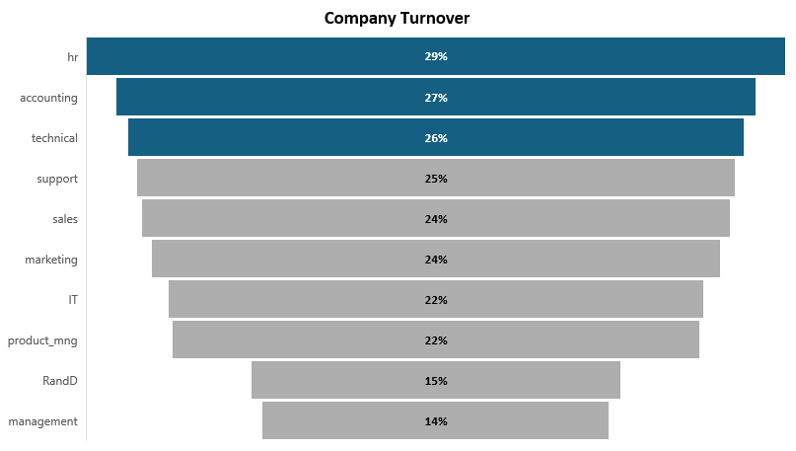
Where Do We Have the Most Churn?
24%
Department Turnover These departments have the most churn. However, we need to ask what is the representation of these departments in the company and what is driving the churn?

Slide 2
Does Salary Affect Employee Retention?
High Churn & Low Salary The department with the most churn also have the most employee in the low salary range
Salary Although salary are lower for the top 3 departments with the lowest retention. Not all the categories have the lowest salaries. However, high medium and high salaries do show greater retention.

Slide 3
Does Salary Affect Employee Retention?
Where are most employees concentrated?
Top 3 Departments by Churn and Employees Although these departments have the most churn there don’t necessarily equal large volume of employee. However, we should evaluate these departments difficult in recruitment.

Slide 4
Is Working Long Hours Affected Churn?
Top 3 Departments by Churn and Long Hours
When evaluating the long hours outliers which would be at the 90th percentile. It’s easy to determine that the technical department has the highest amount of employee in this segment

Slide 5
Summary & Recommendation
Summary:
The overall churn of the company sits at 24%. This indicates there may be an issue since the industry average is between 12 and 15%
We have identified 3 candidates for a pilot program who have the highest churn. Out three segments, the technical has the greatest number of employes at 18% at churn of 26% while HR (29% churn) and accounting (26% churn) make up 5% of employee each, respectively.
Salary and work hours may factor into the department churn with these segments having majority of employees in the low and mid salary ranges. Technical employees have 11% of employee working more than 267 hours month or more per month. This would be the best candidate for the pilot program

